Slide 1
Applies Data Structure and Application
Dr Sachin K Saxena Sr Data Analyst, Portugal, MNC
Ex-Sr Software Engineer - Data Scientist

Slide 3
Content
Searching: Sequential Search,
Binary Search
Comparison and Analysis

Slide 4
Searching Definition and Processes
Searching is an essential operation:
Several ways
Algorithms that search for an element within a collection:
Linear search
Binary search

Slide 5
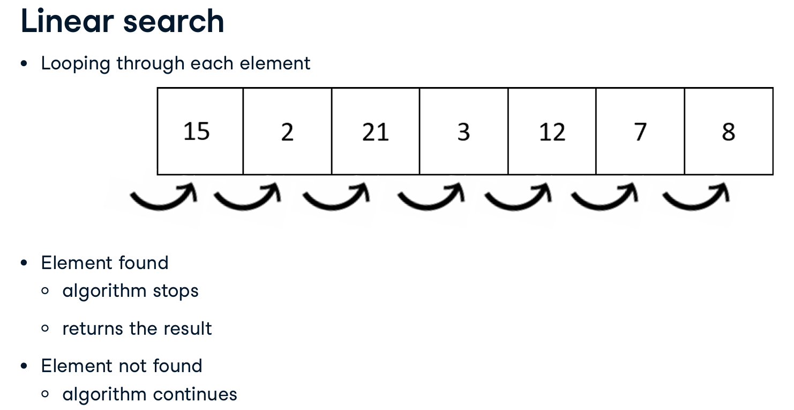
Searching Definition and Processes

Slide 6
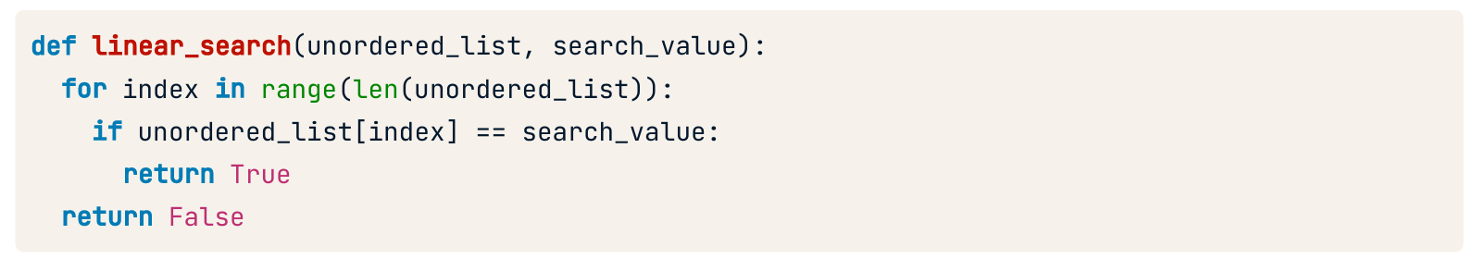
Searching Definition and Processes

Slide 7
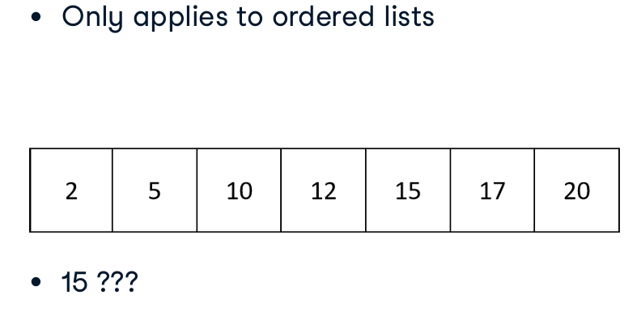
Binary Search

Slide 8
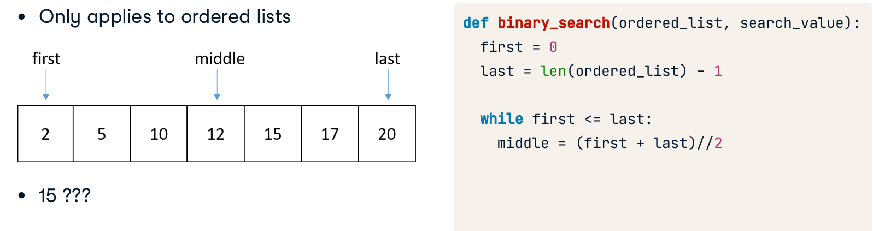
Binary Search

Slide 9
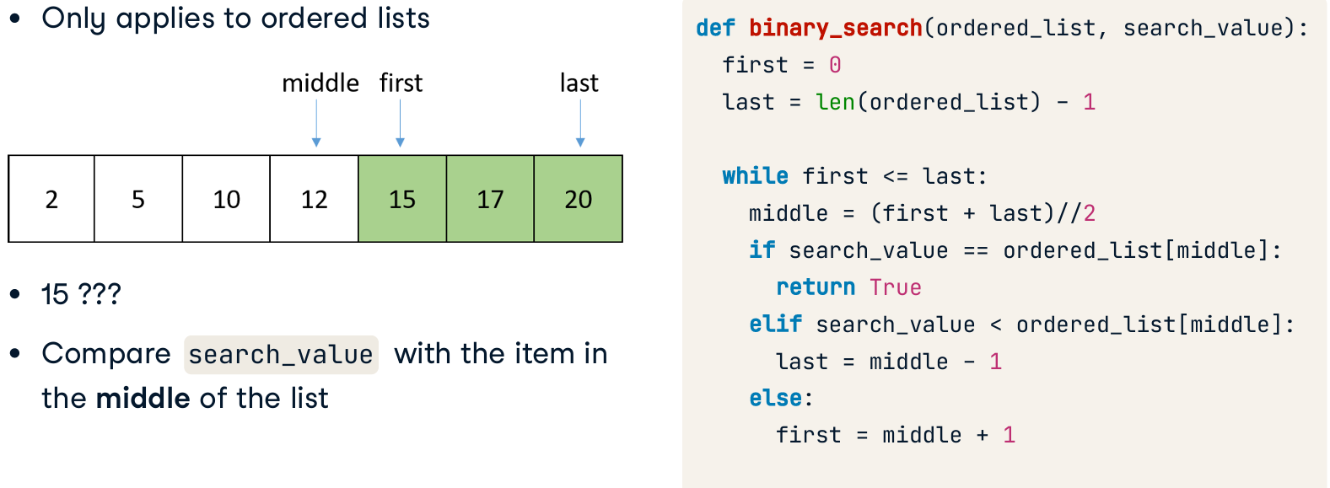
Binary Search

Slide 10
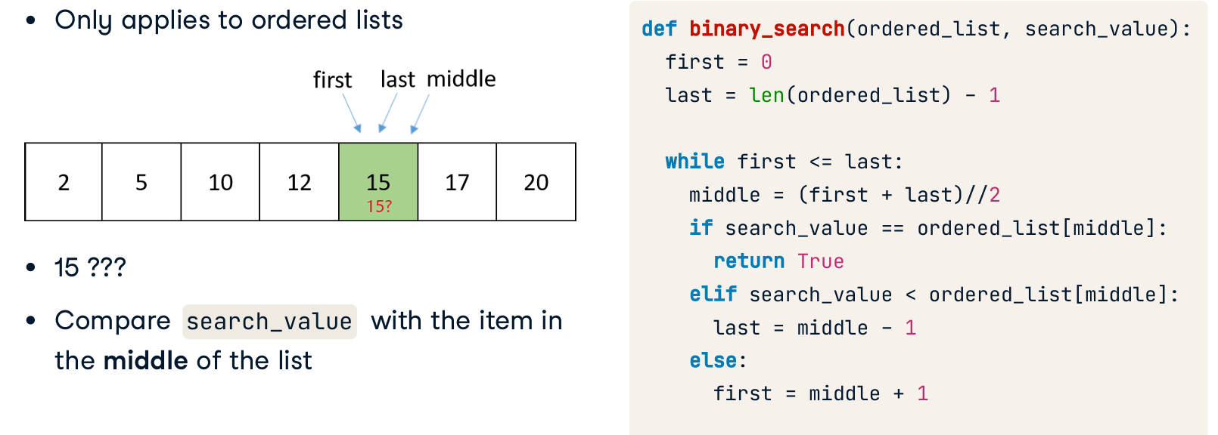
Binary Search

Slide 11
Binary Search implementation:
Iterative Algorithm
Recursive Algorithm

Slide 12
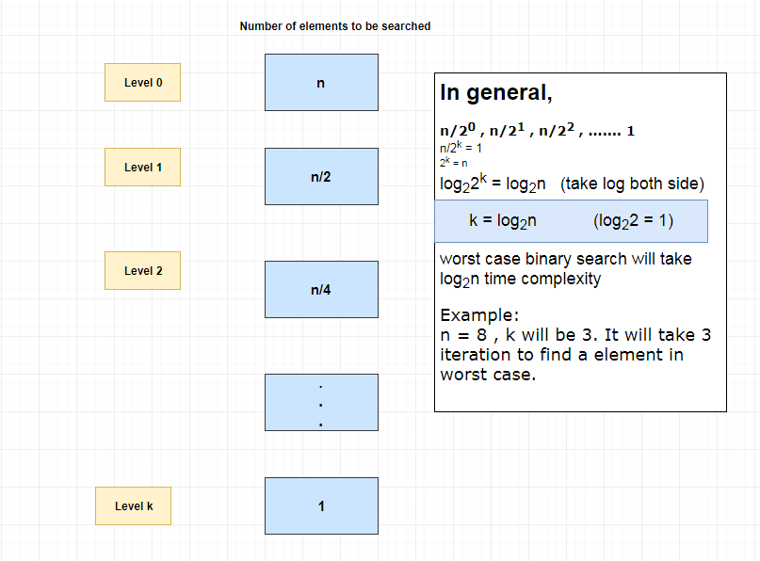
Binary Search Complexity

Slide 13
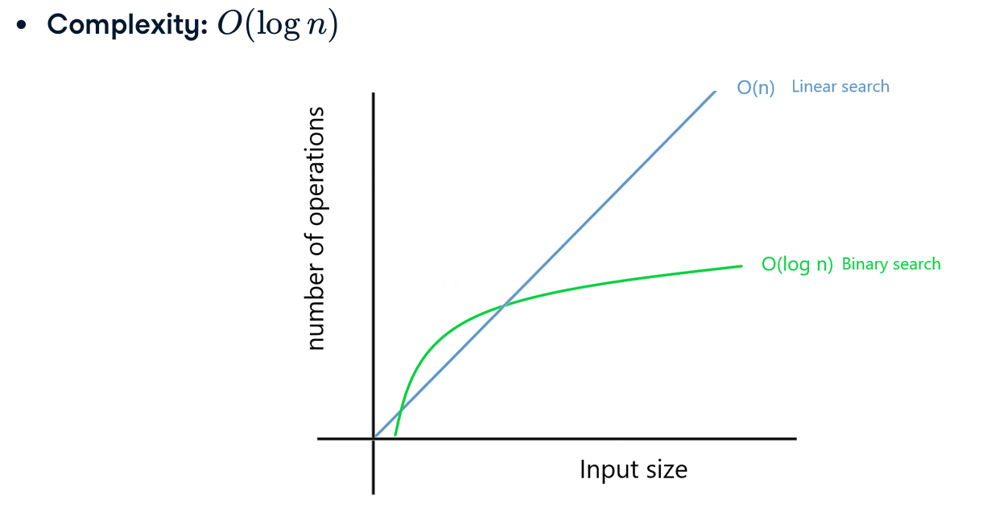
Binary Search Complexity

Slide 14
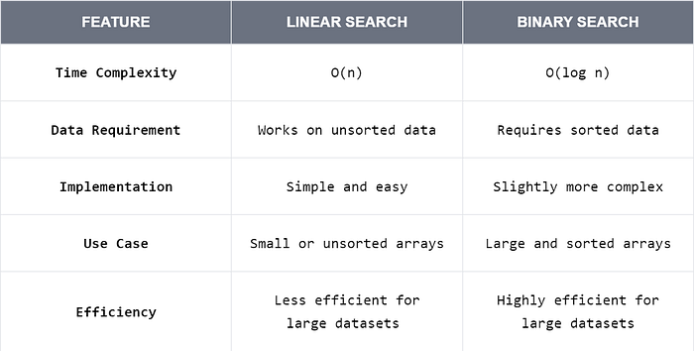
Binary vs Linear Search

Slide 15
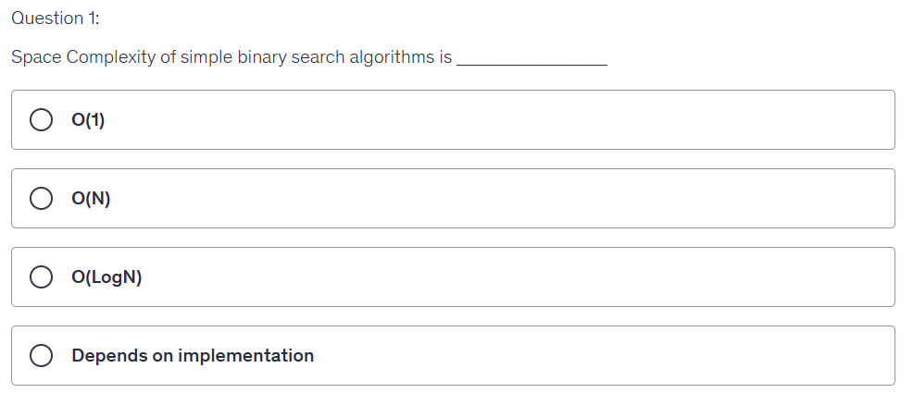
Quiz Time: 1

Slide 16
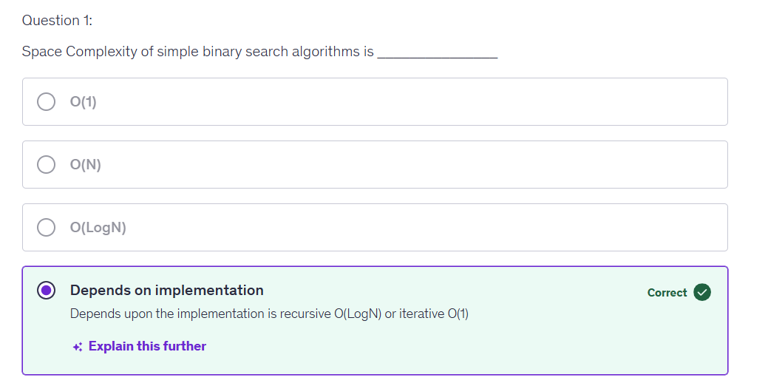
Quiz Time: 1

Slide 17
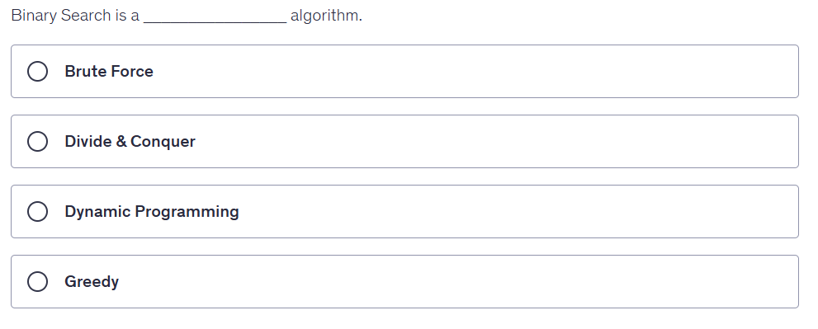
Quiz Time: 2

Slide 18
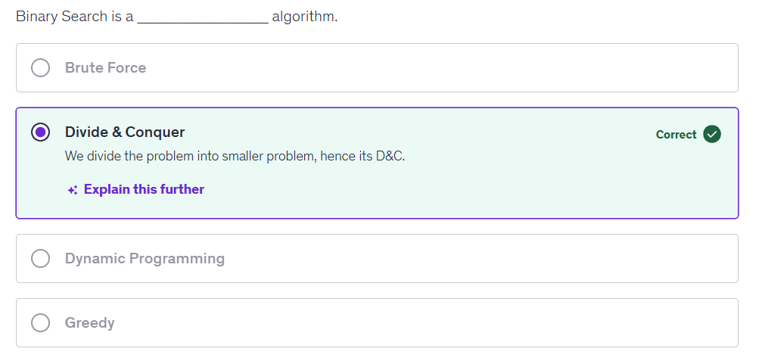
Quiz Time: 2

Slide 19
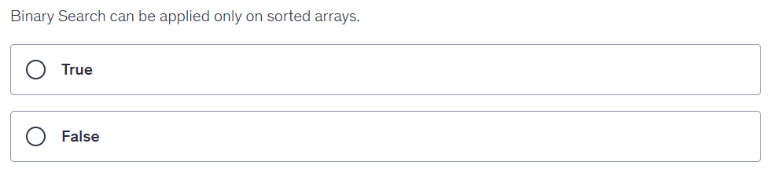
Quiz Time: 3

Slide 20
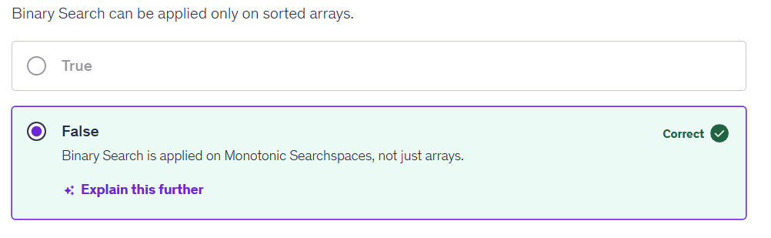
Quiz Time: 3
Binary search on an array only works on a sorted array, binary search on the answer only works if the answer function is monotonic, meaning that it is always non-decreasing or always non-increasing.

Slide 21
Thanking you !!!!
Any question !!!!!
Download PPT : https://github.com/sachin365123/Applies-Data-Structure-and-Application-GLA-Online-Sessions-Jan---Jun-2026

